Slide 1


Lesson 12
Time Complexity
Theory of Computation
王轩
Wang Xuan

Slide 2
Outline
Measuring Complexity
BIG-O and SMALL-O notation
Analyzing Algorithms
Complexity Relationships Among Models

Slide 3
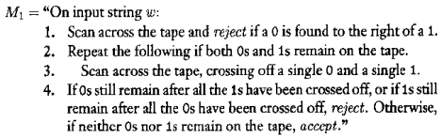
An example
Language A={0^{k}1^{k}|k ≥0}.
How much time does a single-tape Turing machine need to decide A?

Slide 4
Time complexity
Let M be a deterministic Turing machine that halts on all inputs.
The running time or time complexity of M is the function f: N->N, where f(n) is the maximum number of steps that M uses on any input of length n.
M is an f(n) time Turing machine.

Slide 5
Outline
Measuring Complexity
BIG-O and SMALL-O notation
Analyzing Algorithms
Complexity Relationships Among Models

Slide 6
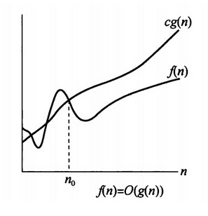
Big-O Notation
Asymptotic analysis
  f(n) =6n³+2n²+2n+45
  f is asymptotically at most n³. The asymptotic notation or big-O notation for describing this relation f(n)=O(n³).
Definition
  Let f and g be functions f, g: N->R⁺. Say that f(n)=O(g(n)) if positive integers c and n₀ exist such that for every integer n ≥ n₀, f(n) ≤c g(n).
  When f(n)=O(g(n)) we say that g(n) is
  an upper bound for f(n), or asymptotic
  upper bound.

Slide 7

Example
f₁(n)=5n³+2n²+22n+6.
  Let c=6, n₀=12. Then 5n³+2n²+22n+6<6n³.
  f₁(n) = O(n³).
  In addition, f₁(n) = O(n⁴).
f₂(n)=3nlog₂n+5nlog₂log₂n+2
  f₂(n)=O(nlogn)
f(n)=O(n²)+O(n)
  f(n)=O(n²)
Bounds of the form n^{c} for c≥0, called polynomial bounds
Bounds of the form for δ ≥0, called exponential bounds

Slide 8
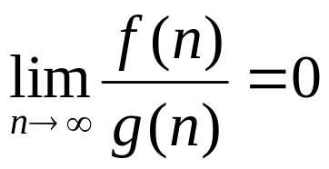
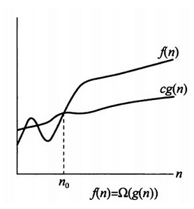

Small-O Notation
Let f and g be function f, g: N->R⁺. Say that f(n)=o(g(n)) if
In other word, f(n)=o(g(n)) means that, for any real number c>0, a number n₀ exists, where f(n)<cg(n) for all n ≥n₀.
Example
  =o(n).
  n=o(nlog(logn)).
  nlog(logn)=o(nlogn)
  nlogn=o(n²).

Slide 9
Outline
Measuring Complexity
BIG-O and SMALL-O notation
Analyzing Algorithms
Complexity Relationships Among Models

Slide 10
Analyzing algorithms
Language A={o^{k}1^{k}|k ≥0}.

Slide 11
Time complexity
Language A={o^{k}1^{k}|k ≥0}.
In stage 1, use 2n steps. We say it use O(n) steps.

Slide 12
Language A={o^{k}1^{k}|k ≥0}.
In stage 2 and 3, each scan use O(n) steps.
At most n/2 scans can occur.
So total time by stage 2 and 3 is O(n²) steps.

Slide 13
Language A={o^{k}1^{k}|k ≥0}.
In stage 4, make a single scan. The time is O(n).
Thus the total time of M₁ on input of length n is O(n)+O(n²)+O(n)=O(n²).

Slide 14
Time complexity class
Let t: N->R⁺ be a function. Define the time complexity class TIME(t(n)), to be the collection of all languages that are decidable by an O(t(n)) time Turing machine.

Slide 15
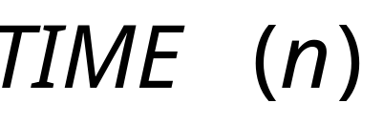
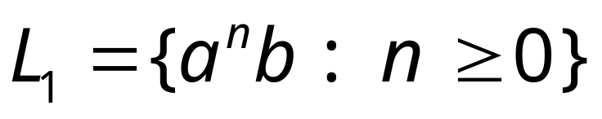
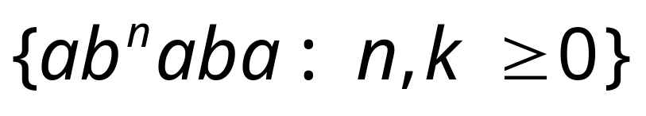
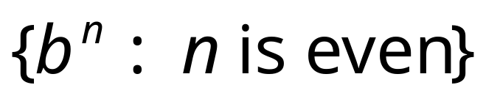
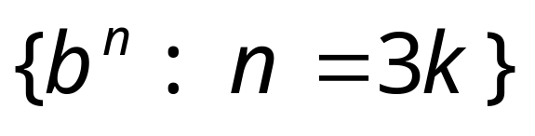
Other example problems in the same class

Slide 16
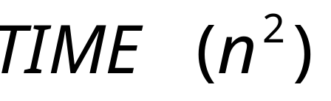
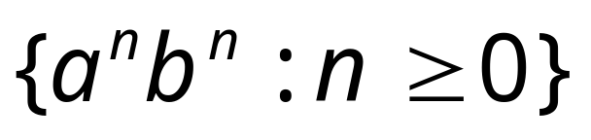
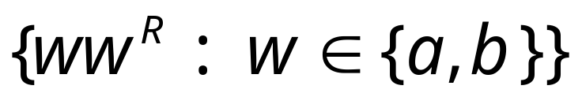
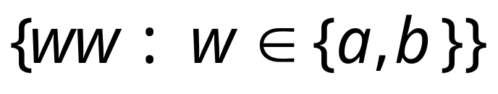
Examples in class:

Slide 17
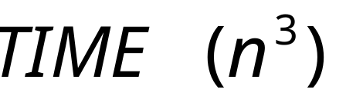
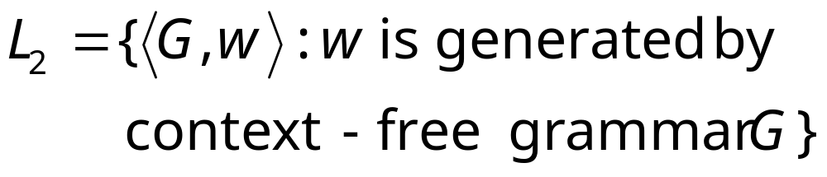
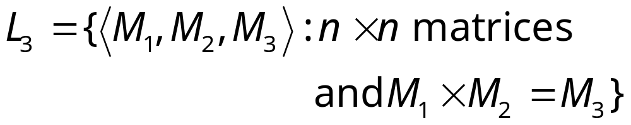
Examples in class:
CYK algorithm
Matrix multiplication

Slide 18
Example:
  A={o^{k}1^{k}|k ≥0}.
  A ∈ TIME(n²), TIME(n²) contains all languages that can be decided in O(n²) time.
Can another TM decide A faster?

Slide 19
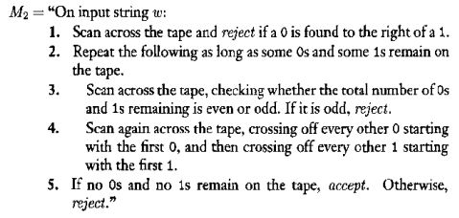
O(n)
The running time of M2 is O(n)+O(nlogn)=O(nlogn)
A ∈ TIME(nlogn)
1+log₂n
O(n)
O(nlog₂n)
O(n)

Slide 20
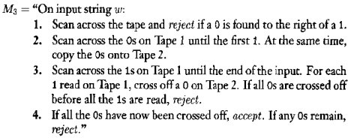
Multitape Turing Machine
O(n)
The total time is O(n).
We observe:
  A single-tape TM decides A in O(nlogn) time.
  A two-tape TM decides A in O(n) time.
O(n)
O(n)
O(n)

Slide 21
Outline
Measuring Complexity
BIG-O and SMALL-O notation
Analyzing Algorithms
Complexity Relationships Among Models

Slide 22
Different TMs
The same language may have different time requirements on different models.
  Single-tape Turing machine
  Multitape Turing machine
  Nondeterministic Turing machine
Let t(n) be a function, where t(n) ≥n.
  1. Every t(n) time multitape Turing machine has an equivalent O(t²(n)) time single-tape Turing machine.
  2. Every t(n) time nondeterministic single-tape Turing machine has an equivalent 2^{O(t(n))} time single-tape Turing machine.

Slide 23
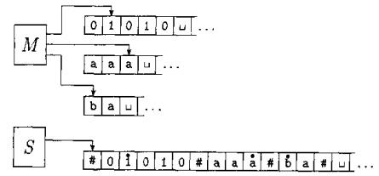
Multitape & single-tape TM
Let M be a k-tape TM that runs in t(n) time. We construct a single-tape TM that runs in O(t²(n)) time.
Machine S operates by simulating M.

Slide 24
Proof
For each step of M
  S scan all the information on its tape to determine the symbols under M’s tape heads.
  Scan again to update the tape content and head position.
The length of active portions of S’s tape is O(t(n))
  Each of the active portions of M’s k tapes has length at most t(n). Because M use t(n) tape cells in t(n) step if the head moves rightward at every step and even fewer if a head ever moves left.
  S’s tape = kt(n)=O(t(n))

Slide 25
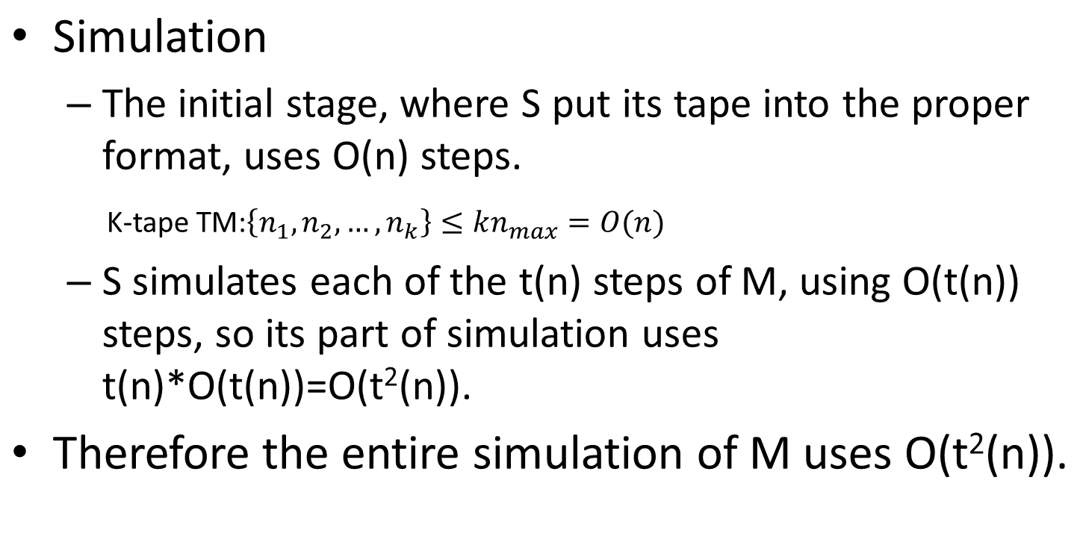

Slide 26
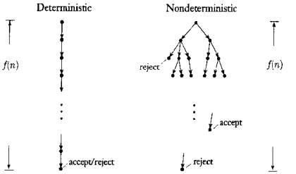
Nondeterministic TM
Let N be a nondeterministic TM that is a decider.
The running time of N is the function f: N->N, where f(n) is the maximum number of steps that N uses on any branch of its computation on any input of length n.

Slide 27
Proof
Proof idea :
1. Change nondeterministic TM to a multitapt TM.(Theorem 3.16)
2. Change multitape TM to a single-tape TM

Slide 28
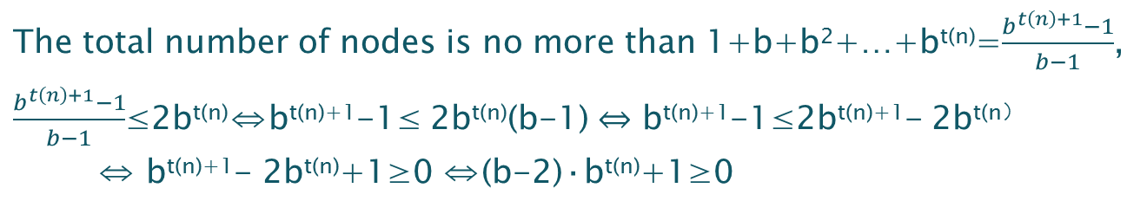
Proof: Step-1
Let N be a NTM running in t(n) time. We construct a deterministic TM D that simulates N.
  On an input of length n, each branch of N’ tree has a length of at most t(n).
  Every node can have at most b children.
  The total number of leaves in the tree is at most b^{t(n)}.
Simulation by exploring the tree first.
  The total number of nodes in the tree is less than twice the maximum number of leaves, O(b^{t(n)}).
  The time for staring from the root to a node is O(t(n)).

Slide 29
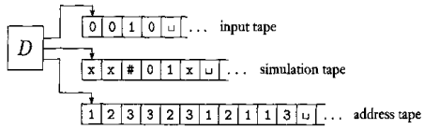
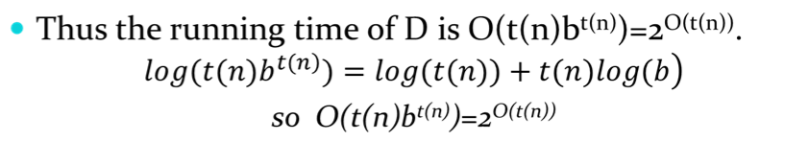
O(t(n)·b^{t(n)}) = 2^{O(t(n))} ⇔ log₂O(t(n)·b^{t(n)}) = O(t(n))
log₂O(t(n)·b^{t(n)})= O(log₂(t(n))+t(n)·log₂b) =
O( log₂(t(n)) )+log₂b·O(t(n)) = O(t(n))

Slide 30
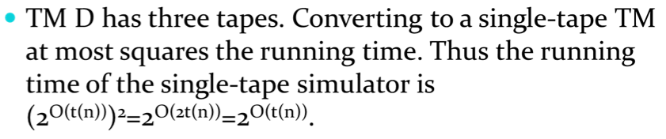
Proof: Step-2

